Slide 1

This practical class needs to be divided into groups, please make a group of 1~3 people.
https://www.shutterstock.com/zh-Hant/image-vector/icon-people-vector-727689157

Slide 2
Developing Spark Projects with Jupyter on Docker
Youteng Liang (梁有騰)
Notes:
Good afternoon mates, welcome to the course about Big Data Technology and Administration,
I am one of the TAs, my name is 梁有騰,
in today’s course, we will tell you how to develop spark projects with jupyter on docker.

Slide 3
Outline
Spark Introduction
Docker Introduction
Docker Installation
Spark Installation with Docker
Practice: Gender Detector with ML
Commit Docker Image
Exercise

Slide 4
Outline
Spark Introduction
Docker Introduction
Docker Installation
Spark Installation with Docker
Practice: Gender Detector with ML
Commit Docker Image
Exercise
Notes:
First thing first, let’s take a look on the outline today.
First chapter is the spark introduction, I will tell you what is spark and why we choose to use spark in this chapter.
Second is the docker introduction, I will tell what is docker and what’s the benefits of developing applications on docker.
And the next chapter is the docker installation, I will tell how to install docker on both Windows and macOS step by step.
Next one is the spark installation with docker, in this chapter, I will tell how to install spark on docker environment.
And we will do a simple practice with spark, which is using ML to build a gender detector with height and weight as input.
Next one is the introduction about how to commit docker container to a docker image, after that you can push your docker image to public.
Finally, we will have a team excise as the homework, which aims to evaluate how you learn in these few hours.

Slide 5

Spark
Apache Spark is an open-source analytics engine for big-scale data processing.
Spark uses in-memory caching, and optimized query execution for fast analytics and queries.
Spark supports Scala, Java, R, and Python in the original version, and .Net, Julia, and more languages with 3rd party support.
https://en.wikipedia.org/wiki/Apache_Spark
Notes:
Apache Spark is an open-source analytics engine for big-data, which provides in-memory caching to achieve better calculation speed.
You might ask: how about the memory usage? It sounds like 10GB memory requirement. Don’t worry about that, spark also provides optimized query execution and storage, that won’t take too much memory.
And Spark also support lots of programming languages, such as Scala, Java and Python, and it also support .Net with some 3rd party extentions.

Slide 6
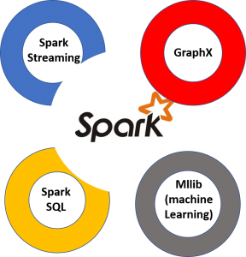
Why Spark?
In-memory caching and processing
Spark streaming for real-time analytics
GraphX for graph processing
Spark Mllib for machine learning
Spark SQL for queries
https://aws.amazon.com/tw/big-data/what-is-spark/
Notes:
There five benefits of using spark,
First is the fast calculation and processing with in-memory caching.
Second is spark streaming supports real-time analytics.
Three is that we can use GraphX to process graph data.
And spark also support ML with Spark Mllib
And the final one is that spark provides spark SQL to achieve optimized queries.

Slide 7
Outline
Spark Introduction
Docker Introduction
Docker Installation
Spark Installation with Docker
Practice: Gender Detector with ML
Commit Docker Image
Exercise

Slide 8
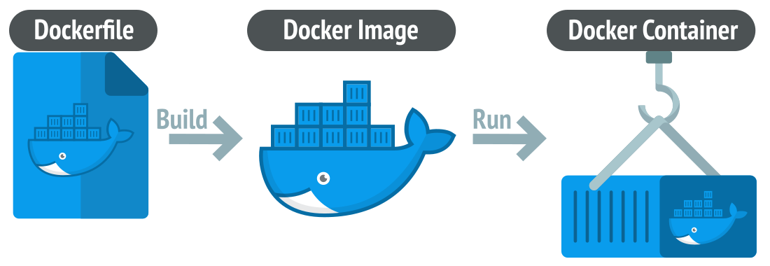
Docker
Docker is an open-source platform, which is for fast developing, shipping, and executing applications.
A docker image usually contains lots of containers, each of them having an independent environment.
Docker images can be pushed to Docker Hub or other repositories; Docker can be pulled and then executed on other computers.
https://linuxiac.com/what-is-docker-container/
Notes:
Docker is an open-source platform, which aims to provide a fast application develop, ship and execute env.
A docker image that consists of lots of containers can be built with a docker file, and each of container can run a application independently.
Then we can push the docker images to docker hub or other repositories for cross device operations.
Please look at these picture, which describes the flow of docker usage.
After we developing a application, we can build a docker image with docker file, and the application you built will be packed into a docker container.

Slide 9
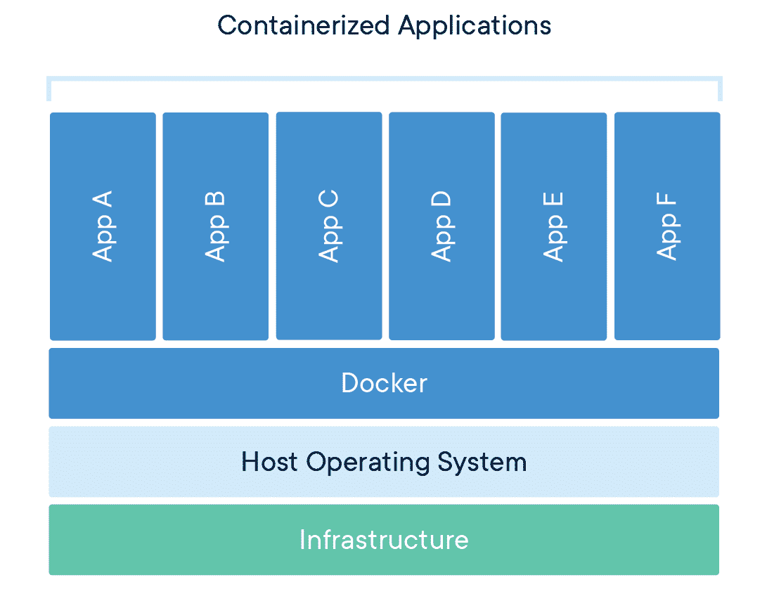
Docker Container
https://www.docker.com/resources/what-container/
Notes:
This picture is the architecture of docker.
Each application is run on different containers independently, and that shared the same operation system and docker env.
This design can decrease the host hardware requirements since different docker containers no need to emulate a whole operating system.

Slide 10
Outline
Spark Introduction
Docker Introduction
Docker Installation
Spark Installation with Docker
Practice: Gender Detector with ML
Commit Docker Image
Exercise

Slide 11
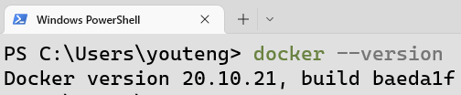
Docker Installation for Windows
Download Docker Desktop and install it.
Execute wsl_update_x64.msi to upgraded WSL to WSL2.
Reboot your computer.
Launch Docker Desktop.
Type the command in your terminal to check if installed.
Notes:
Download Docker Desktop and install it.
Execute wsl_update_x64.msi to upgraded WSL to WSL2.
Reboot your computer to enable WSL2.
Launch Docker Desktop.
Type the command in your terminal to check if installed.

Slide 12
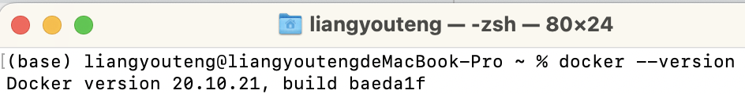
Docker Installation for macOS
Download Docker Desktop and install it.
Reboot your computer.
Launch Docker Desktop.
Type the command in your terminal to check if installed.
Notes:
It’s a little bit simpler for macOS.
We just need to download docker desktop and install it.
Then launch it after reboot your computer.

Slide 13
Outline
Spark Introduction
Docker Introduction
Docker Installation
Spark Installation with Docker
Practice: Gender Detector with ML
Commit Docker Image
Exercise

Slide 14
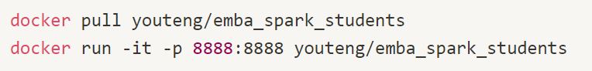
Spark Installation with Docker
Using pull to pull a pre-build docker image from Dock Hub.
Using run to run a docker image, and the port will be set as 8888:8888 with parameter –p.
Notes:
Then we can use pull command to download a pre-built docker image from docker hub.
After downloading, we can run a docker and specify the port as 8888 with –p parameter. Please note that we need to specify the port as 8888 because of the jupyter requirement.

Slide 15
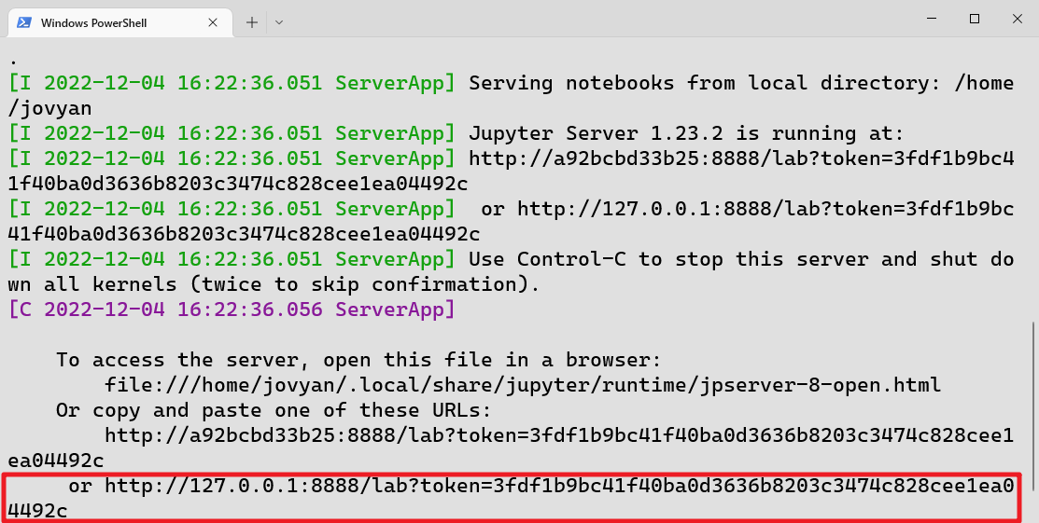
Jupyter Lab
After you run the command, a unique URL to the local jupyter lab is created.
Click the link to open Jupyter lab.

Slide 16
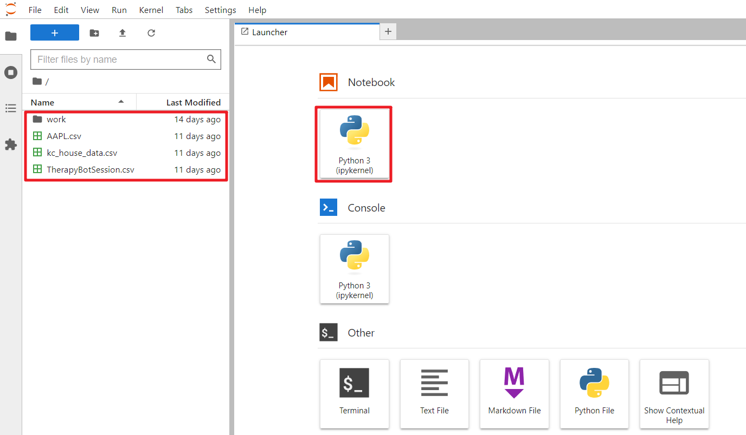
Jupyter Lab (Cont’d)
Notes:
Welcome to the jupyter lab user interface,
we can check and upload files on the left side in your screen.
You will see three .csv files are included, which are the data you will need for the course next week.
In this docker image, all the data and environments for the course of these two weeks are included,
You can use this image to finish all things in these two weeks easily.

Slide 17
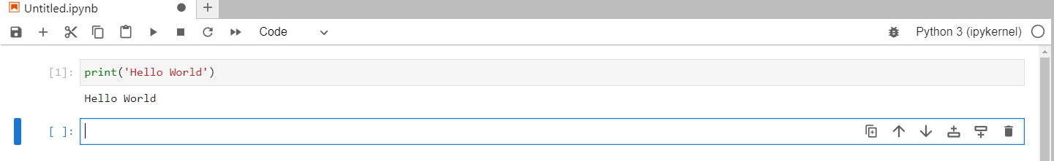
Jupyter Notebook
Code cell
Notebook name
Execute button
Python Code
Output
Notes:
So let’s take a look on the user interface of jupyter notebook
You can change the notebook name here.
You can execute the python code by clicking the execute button.
Then a notebook usually consists of lots of code cells, each of which consists of lines of python code.
Then after executing a code cell, the output will be shown on the screen if it has.

Slide 18

Google Colab
Before we start coding, we should know how to use Colab.
Colab allows you can write & run python code online.
Colab provides free GPU resources for Machine learning (ML) and model training.
https://clay-atlas.com/blog/2019/09/29/colab-chinese-tutorial/
Notes:
If you can’t install docker successfully, you can use colab as the alternative.

Slide 19
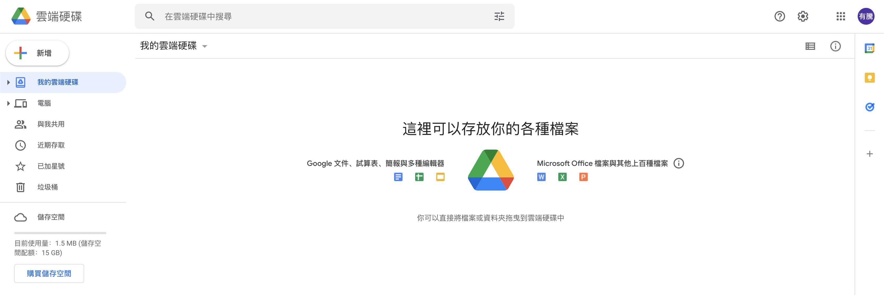
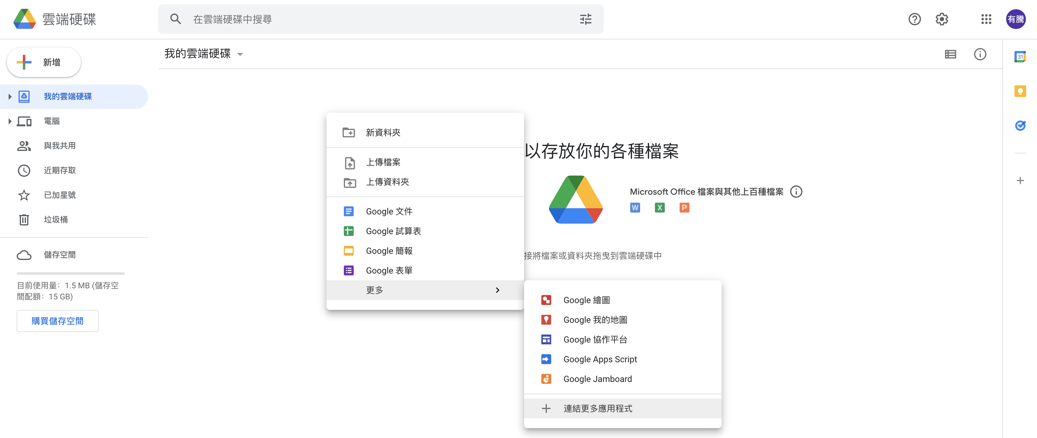
Connect Colab into Google Drive
We should connect Colab into google drive before we use it.
Right Click
Notes:
The steps are as the following figure.

Slide 20
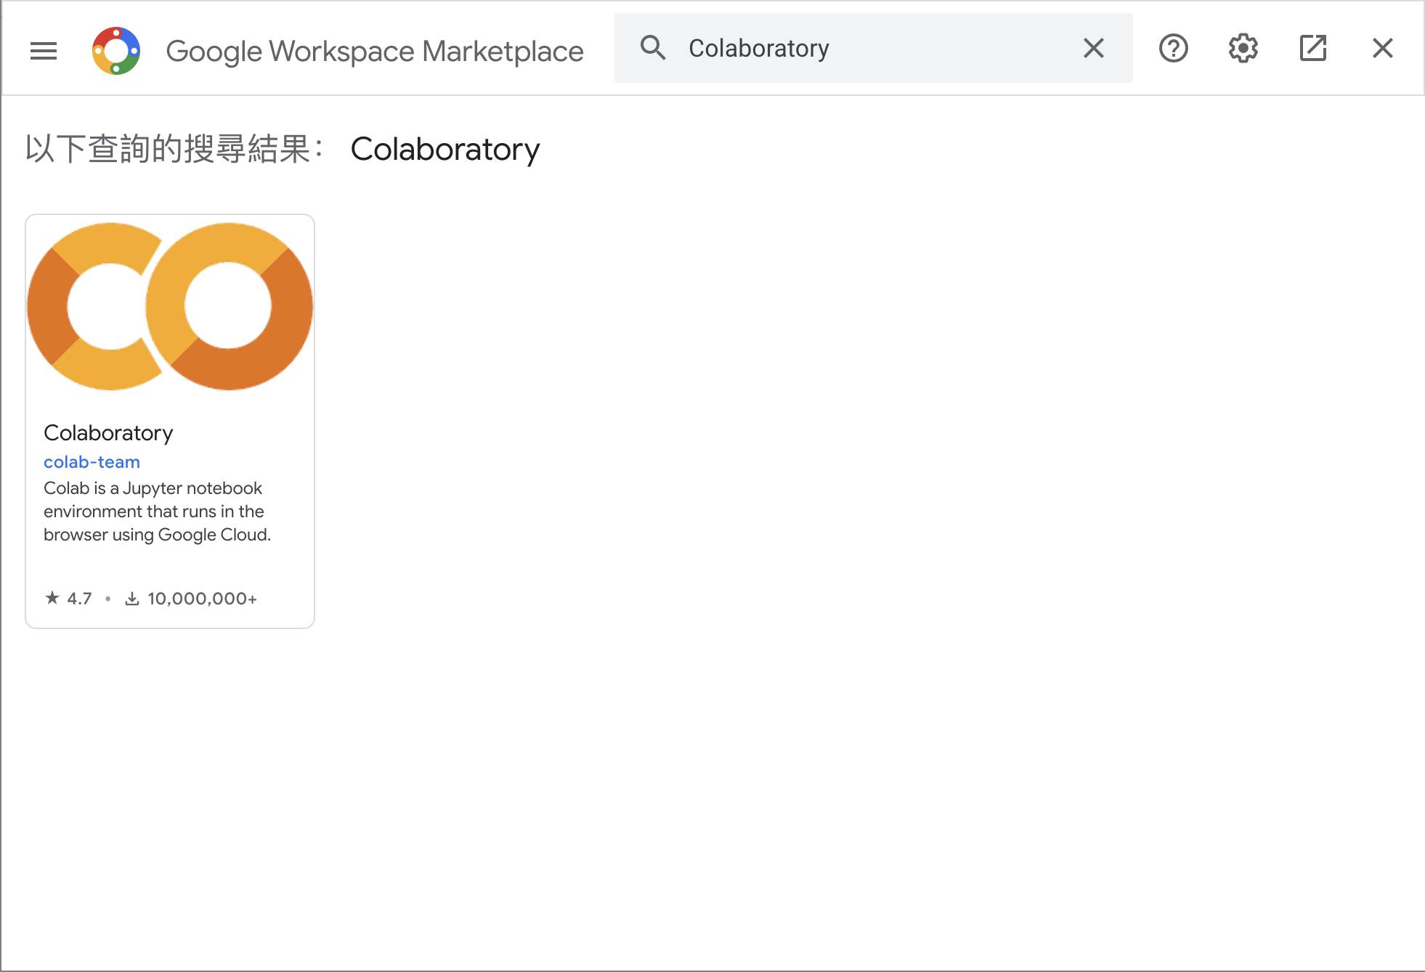
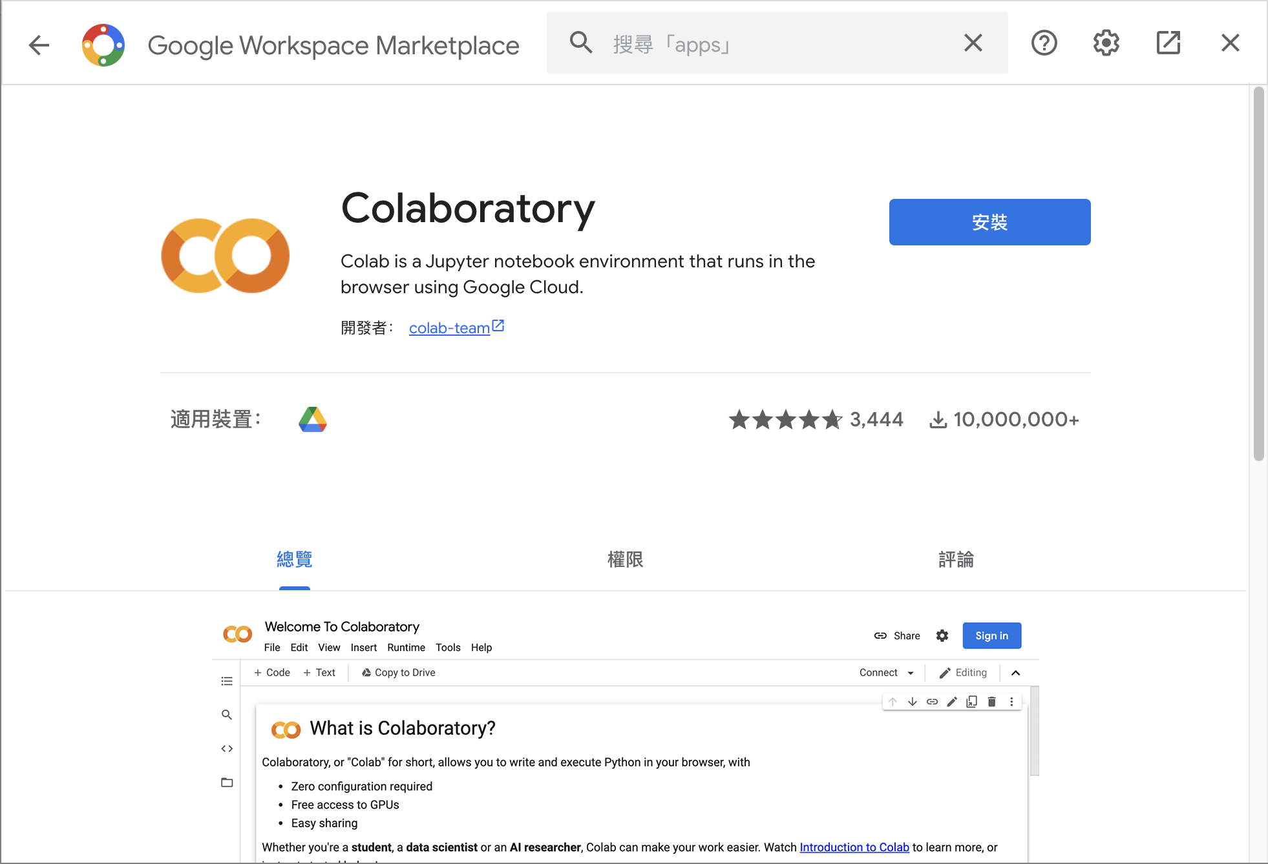
Connect Colab into Google Drive (Cont’d )
Search Colab and install it.

Slide 21
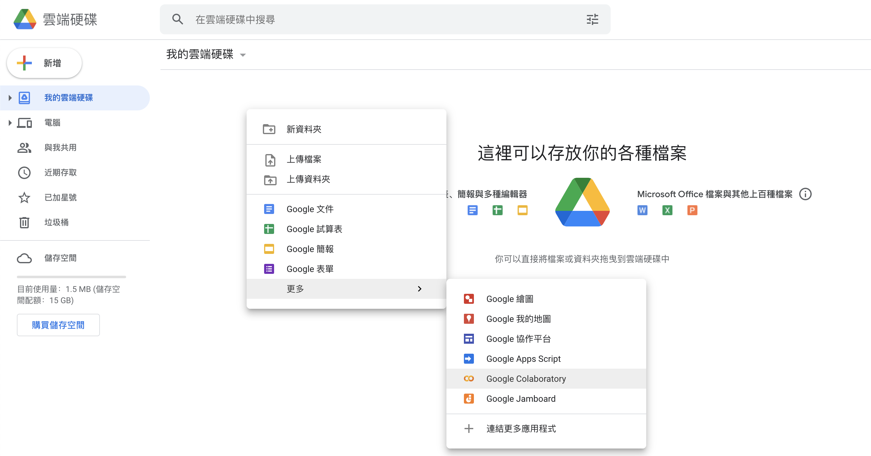
Connect Colab into Google Drive (Cont’d )
After installation, you can create a new Colab notebook.
Notes:
The steps are as the following figure.

Slide 22
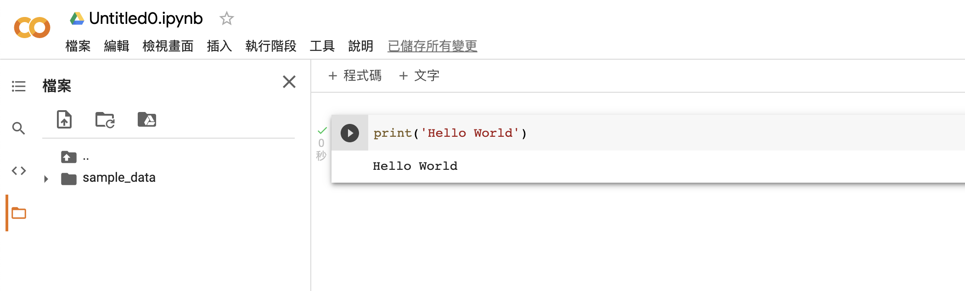
Colab User Interface (UI)
Notebook name
Python code
Code cell
Files
Output
Execute button
Notes:
This page is a description of the colab user interface.

Slide 23
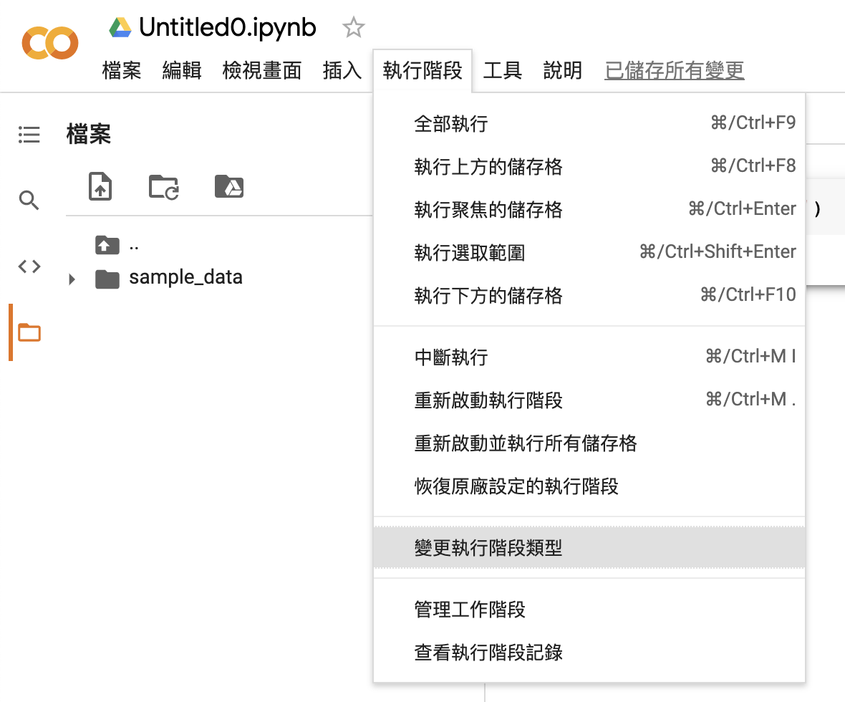
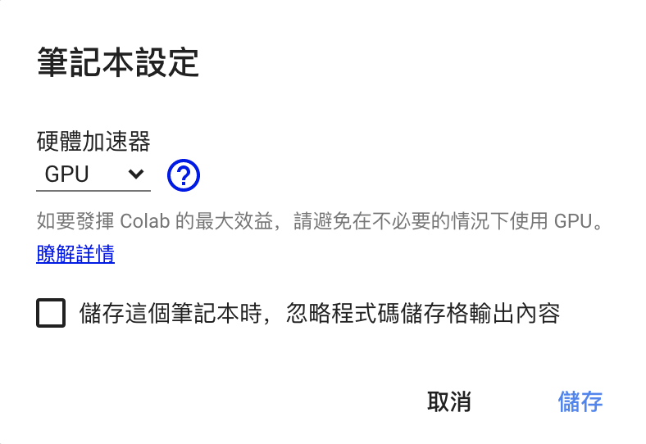
Change to Use GPU
We can change to GPU hardware accelerator.
Notes:
The steps are as the following figure.

Slide 24
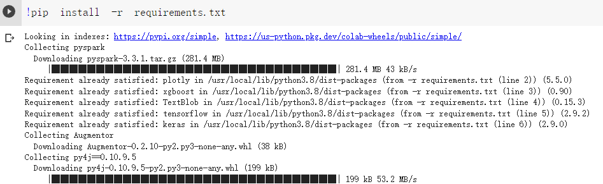
Install Pyspark on Colab
Install all the packages we need with the Python pip command.

Slide 25
Outline
Spark Introduction
Docker Introduction
Docker Installation
Spark Installation with Docker
Practice: Gender Detector with ML
Commit Docker Image
Exercise

Slide 26
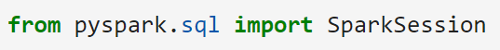
Spark Session
Spark session is a python class, which provides all the functions for processing data with spark.
We can import pyspark.sql for query data.

Slide 27
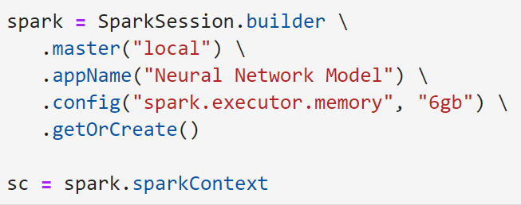
Spark Builder
Using builder to build the spark environment.
Notes:
Using builder to build the spark environment with app name is neural network model, which can use at most 6GB of memory.

Slide 28
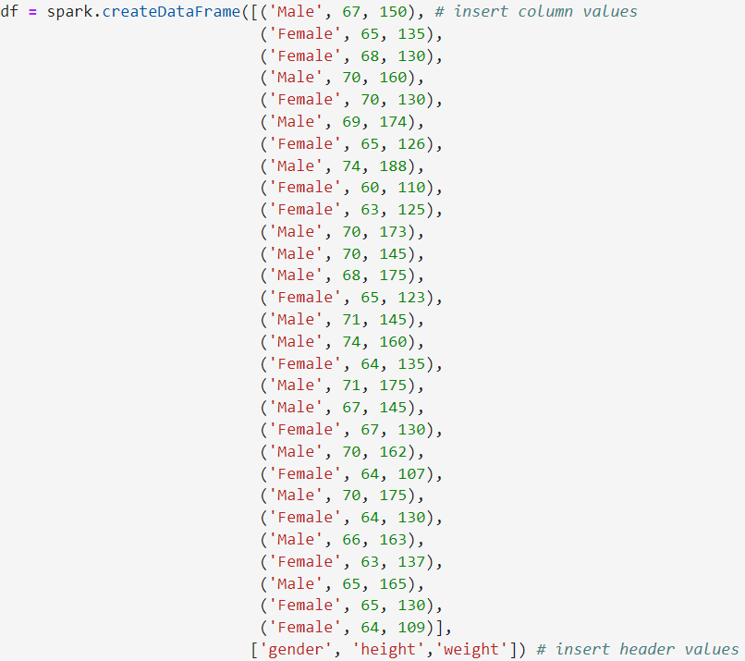
Data Frame
Notes:
Then we can use createDateFrame() to create our data.

Slide 29
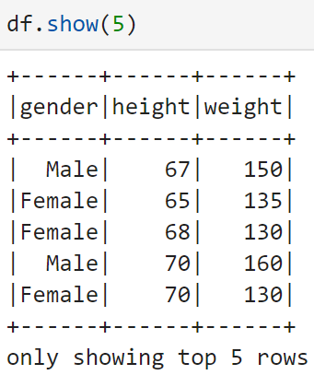
Show Data Frame
We can use show() to show the data.
Notes:
We can use show() to show the data, the parameter of that function indicates how many rows you want to show.

Slide 30
SQL Functions
We can import functions from pyspark.sql to query data.
When() is similar to the WHERE keyword of SQL.
Select() is the same as SELECT in SQL.
Notes:
As we mentioned, Spark can invoke SQL queries.
We can query the data with these function easily.
In this page, we need to transfer gender from female or male to 0 or 1,
we can use when() to select all the data with gender equals to female, then fill it to 0, and otherwise, fill it to 1.

Slide 31
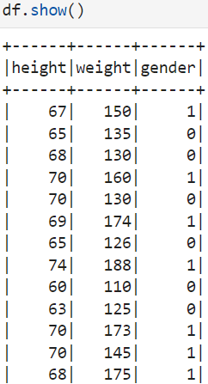
Show Data Frame
Using show() to show the data frame.
Notes:
After selecting the data, we can use show() to show all the data.

Slide 32
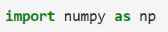
NumPy
NumPy is a basic library required for scientific operations using Python, including array operations that we will use later.
You can invoke the NumPy functions with np.
Load NumPy with import numpy as np.

Slide 33
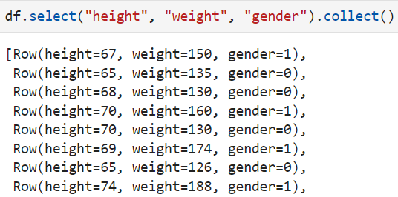
Collection
Collection is a data type in programming languages, which is used to store data.
Using collect() to transfer the data frame to a collection.
Notes:
Talked about array, we should know what a collection is.
Collection is a data type in programming languages, which aims to store data.

Slide 34
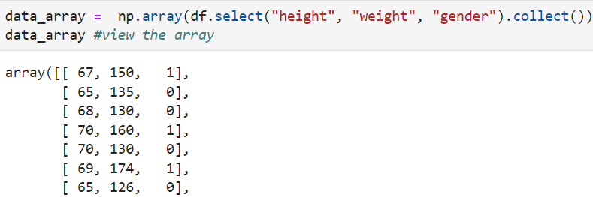
NumPy Array
NumPy array is a common data structure used to store and process data for data analytics.
Using array() to transfer the data frame to an array.
Notes:
After the transferring, we can further transfer the collection to NumPy array.

Slide 35
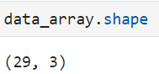
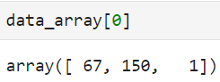
Numpy Array (Cont’d)
Using shape to print the shape of a NumPy array.
Using an index to get the data in a specified space.
Notes:
After the transferring, we can use Shape to print out the shape of our array.
We can see that our data_array consists of 29 rows, and each of which contains three columns

Slide 36
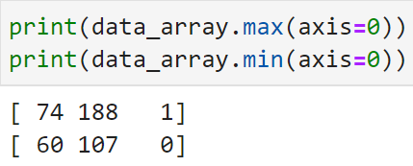
Max and Min
Using the built-in functions of NumPy can easily print maximum and minimum elements in an array.
Specify axis = 0 to find the value along axis 0.
Notes:
0 means along the rows, and 1 means columns.

Slide 37
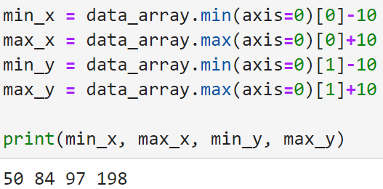
Data Visualization
First, the min and max values of both axis should be determined.
Notes:
We can try to visualize the input data.

Slide 38
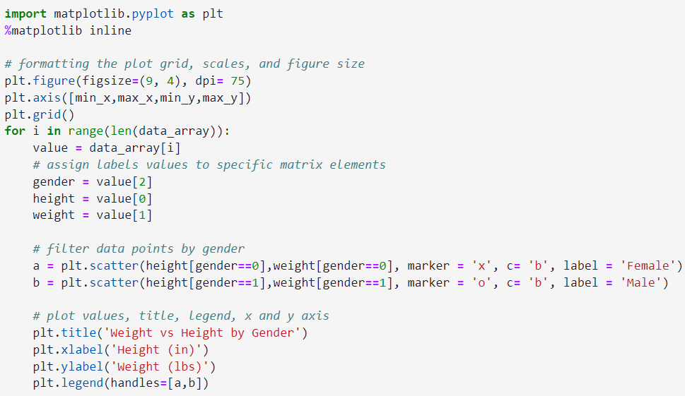
Data Visualization (Cont’d)
Notes:
That’s the code to plot the data as a dot diagram.
Using two markers to indicate different genders.

Slide 39
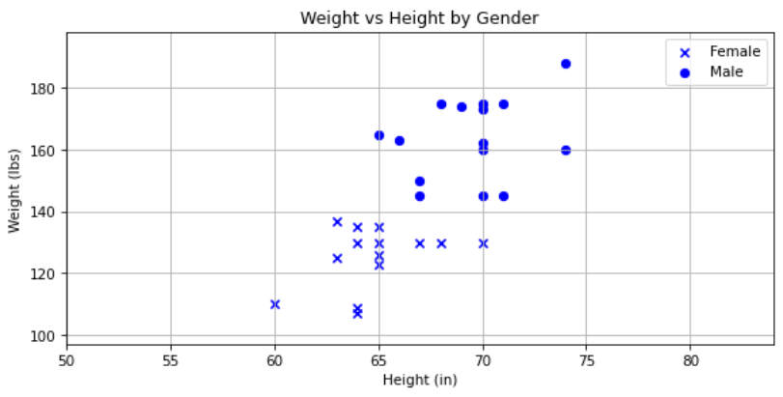
Data Visualization (Cont’d)
Notes:
The visualized result.

Slide 40
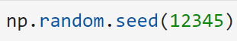
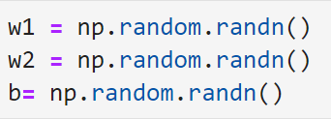
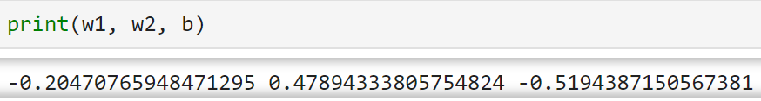
Weights and Bias Initialization
Both weights and bias can be initialized with random numbers.
After specifying the seed, the random numbers can be generated with randn().
Notes:
For ML, the weights and bias are very important, we can initialized them as random numbers.
We can specify the random seed for random function, using 12345 as example here.

Slide 41
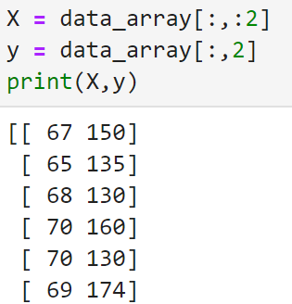
Data Slicing
The data should be split into training data and labels.
Collection slicing provided by Python can help us to achieve that.
Notes:
For supervised learning, the data should be split into questions and answers,
We can use slicing to achieve that.

Slide 42
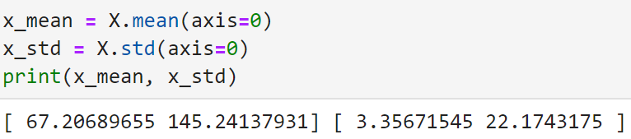
Data Normalization
Data should be normalized for better training performance.
Mean() and std() can be used to take the mean and standard deviation of a collection in Python.
Notes:
Before we start to train our model, the data should be normalized for better training performance.
The simplest Normalization method is to do the calculation with the mean and standard deviation

Slide 43
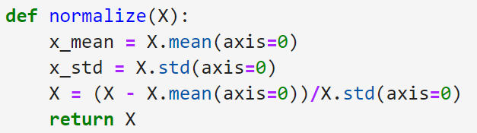
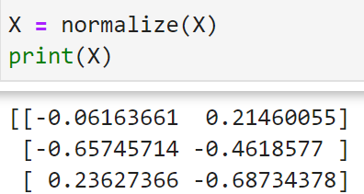
Data Normalization (Cont’d)
A function can be defined to do the normalization.
Notes:
After we get the mean and standard deviation of the input, we can normalize the data with it.
And we can define a function to return the normalize values.

Slide 44
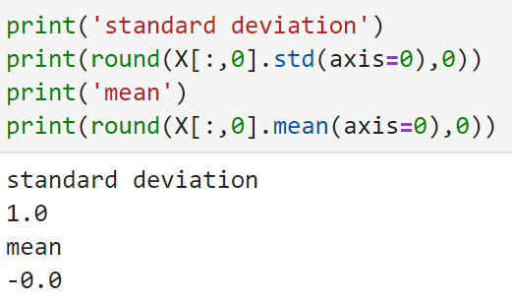
Data Normalization (Cont’d)
The normalized result can be printed.

Slide 45
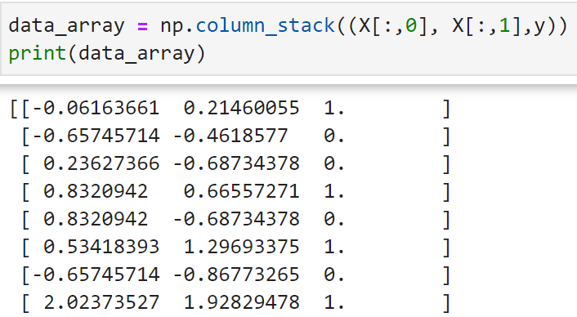
Data Normalization (Cont’d)
The normalized X and y should be combined with column_stack().
Notes:
This function will combine the rows along the columns.

Slide 46
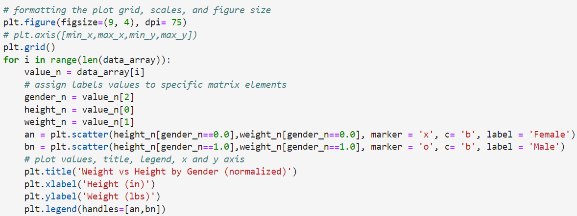
Data Visualization
Visualize the normalized data.
Notes:
That’s very similar to Visualize the original data, we can see the result.

Slide 47
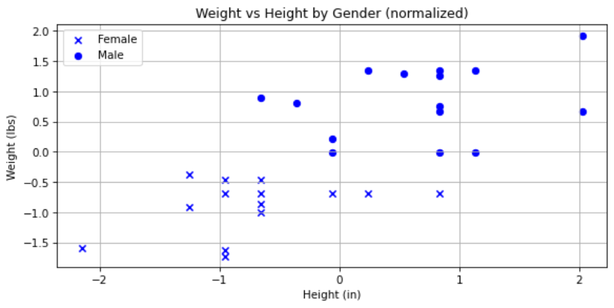
Data Visualization (Cont’d)

Slide 48
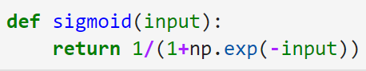
Sigmoid
Sigmoid is an algorithm for machine learning, the output will be [0..1].
The sigmoid can be implemented with exp() easily.

Slide 49
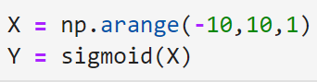
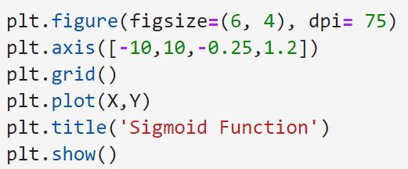
Visualize Sigmoid
Arange() is to generate a collection with evenly spaced values within a given interval.

Slide 50
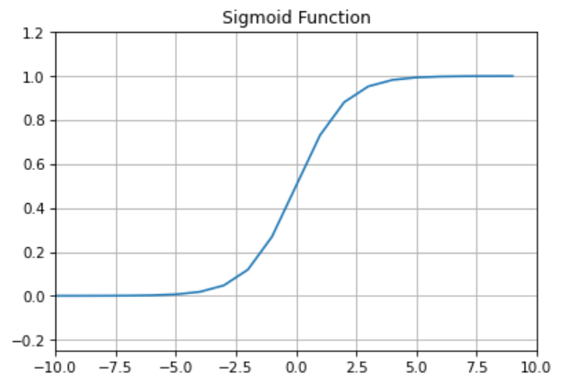
Visualize Sigmoid (Cont’d)

Slide 51
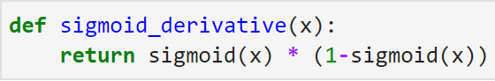
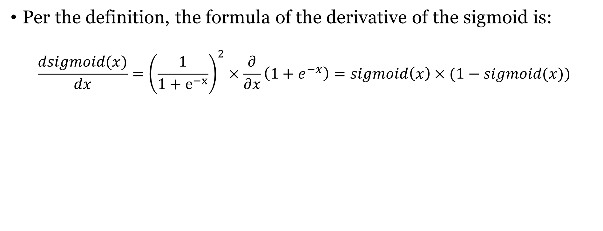
Derivate of Sigmoid
Per the definition, the formula of the derivative of the sigmoid is:
$$\frac{dsigmoid(x)}{dx}={\left(\frac{1}{1+e^{−x}}\right)}^{2}×\frac{∂}{∂x}\left(1+e^{−x}\right)=sigmoid\left(x\right)×(1−sigmoid(x))$$
Notes:
For ML, we not only need the sigmoid function but also the derivative of sigmoid
After the calculations, the formula of the derivative of the sigmoid is:
We can define a function to achieve that.

Slide 52
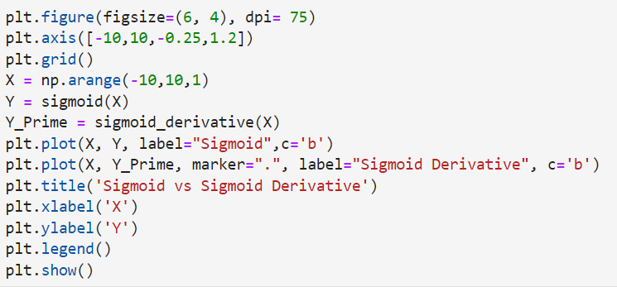
Visualization
Notes:
Also, we can Visualize the sigmoid and its derivative in the same figure.

Slide 53

Visualization (Cont’d)

Slide 54


Randomize the data
Before we start training, we should extend and randomize the data.
Notes:
The original data consists of 29 columns, and we extended it to 100.

Slide 55

Training
The learning_rate will be set to 0.1.
The all_costs[] is initialized.
Notes:
Learning rate means how fast your model learn.
Initialized a list called all_costs, which aims to store all the costs we need during each iteration.

Slide 56

Training (Cont’d)
A random person will be taken to calculate.
Notes:
For each iteration, the data of a random person will be taken to calculation.

Slide 57

Training (Cont’d)
Calculate the result, then compare it with the actual gender as the cost value.

Slide 58

Training (Cont’d)
Both weights and biases should be adjusted with the result.
Notes:
After we got the differences, we can use that to adjust the weights and biases for better learning.

Slide 59

Training (Cont’d)
Notes:
The whole code of training, which consists of 10000 iterations.

Slide 60

Visualize the Result
Notes:
We can Visualize all the costs of each iteration.

Slide 61

Print Weights and Bias

Slide 62

Check the Result
Notes:
We can check whether the result is right with the actual answers.

Slide 63

Define the Normalize Function
Notes:
Now we are going to evaluate our model.
Before that, we should define a function to normalize the input data.

Slide 64

Define the Predict Function
Notes:
And a predict function can be defined.
We can specify that if the score is bigger than or equal to 0.5, the gender is female, otherwise, is male.

Slide 65


Evaluate the Model
The height and weight can be determined to evaluate the trained model.

Slide 66


Evaluate the Model (Cont’d)

Slide 67

Visualize the Result
Determine the min and max values of both axes.
Notes:
Then we can try to Visualize the predict results. Before that, the min and max values of both axes should be determined.

Slide 68
Visualize the Result (Cont’d)
Using arange() to generate the collections.

Slide 69
Visualize the Result (Cont’d)
The data can be combined with for loop.

Slide 70

Visualize the Result (Cont’d)

Slide 71

Visualize the Result (Cont’d)

Slide 72
Outline
Spark Introduction
Docker Introduction
Docker Installation
Spark Installation with Docker
Practice: Gender Detector with ML
Commit Docker Image
Exercise

Slide 73

Sign-in to Docker Hub
Click the sign-in button on the docker desktop.

Slide 74

Sign-in to Docker Hub (Cont’d)
Sign-in or Sign-up to the Docker Hub.

Slide 75

Sign-in to Docker Hub (Cont’d)
Click the proceed button after signed-in.

Slide 76

Sign-in to Docker Hub (Cont’d)
After signed-in, the user name will be shown on the docker desktop.

Slide 77

Create Repository
Open Docker Hub and Click the Create repository button.

Slide 78

Create Repository (Cont’d)
Input the name and description of the repository, then click the Create button.

Slide 79

Create Image Tag
Using docker tag command to create a new docker image tag on the terminal.
Please note that the new_image name should be the same as the repository you created.
The format is:

Slide 80

Create Image Tag (Cont’d)
After tagging, a new image should be shown on your docker desktop interface.

Slide 81
Check the Container ID
Using docker ps –all to list all the containers on terminal.
Notes:
We should copy the id, which is needed later.

Slide 82

Commit Container
Using the commit command to commit the local change to the specified docker image.
A hashed value will be shown after committing.
Format:
Notes:
After we get the container ID.
After commiting, a hash value will shown on your terminal.

Slide 83

Push to Docker Hub
Using push to push the docker image to a specified repository.
Format:

Slide 84

Push to Docker Hub (Cont’d)

Slide 85

Push to Docker Hub (Cont’d)
The docker image will be shown on the docker hub after pushing.

Slide 86
Outline
Spark Introduction
Docker Introduction
Docker Installation
Spark Installation with Docker
Practice: Gender Detector with ML
Commit Docker Image
Exercise

Slide 87
Exercise
That is a little bit inaccurate to determine the gender of a person with only height and weight.
Please add a factor which is the body fat percentage of a person and re-train your model.
That will be fascinating if you want to add other factors to make the model better.
Please gather the data on body fat percentage and other factors from the internet to create reliable results.

Slide 88
Extra Bonus
After introducing Docker, can you describe the differences between Docker containers and virtual machines (VMs)? And what situations are using Docker containers better than VMs and what are not?

Slide 89
Send Your Works
Please upload the works you have done to the docker hub with a repository named username/studentID_emba_spark.
Please send the repository name and the answers to the mail: t110368151@ntut.org.tw
The deadline for this exercise is 12/27/2022.

